Slide 1
Watershed

Slide 2
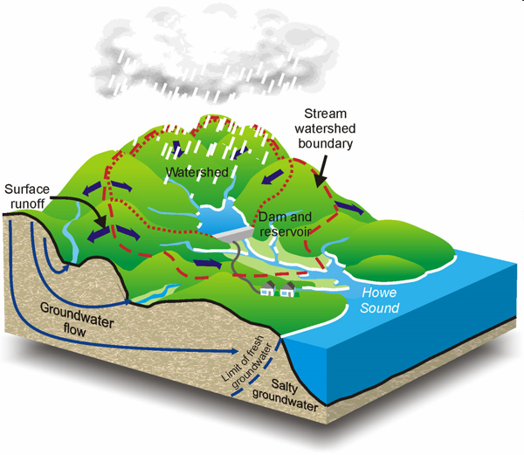
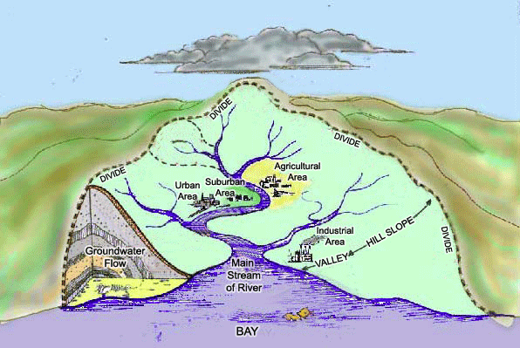
Watershed (Drainage Basin)
Is an area of land that drains to a common body of water, whether a stream, river, or lake.

Slide 3
Water Shed
The are many sub-watersheds that drain into larger rivers and larger watersheds
Drainage Divide
The watersheds are surrounded by higher elevation ridges or hills (boundary), forcing the runoff into the stream, river, or lake.

Slide 4
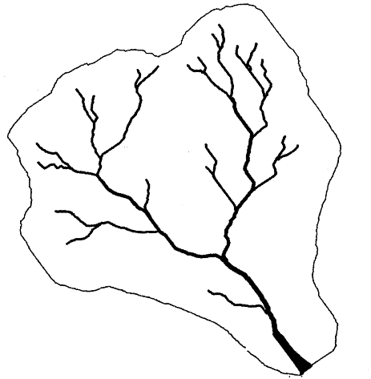
Watershed

Slide 6
http://youtu.be/BYwa_0w1jGY

