Slide 1
BIOLOGY Final Exam Review
CH 7.4, CH 8, CH 9

Slide 2
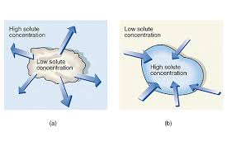
Concentration inside/outside cell
The solute concentration outside the cell is high
Thus water wants to move out to balance the environment.

Slide 3
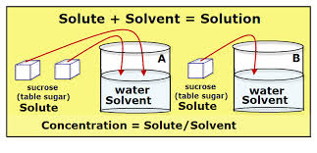
Concentration
Concentration decreases
when you add solvent to a solution
Concentration increases
when you remove solvent to a solution

Slide 4
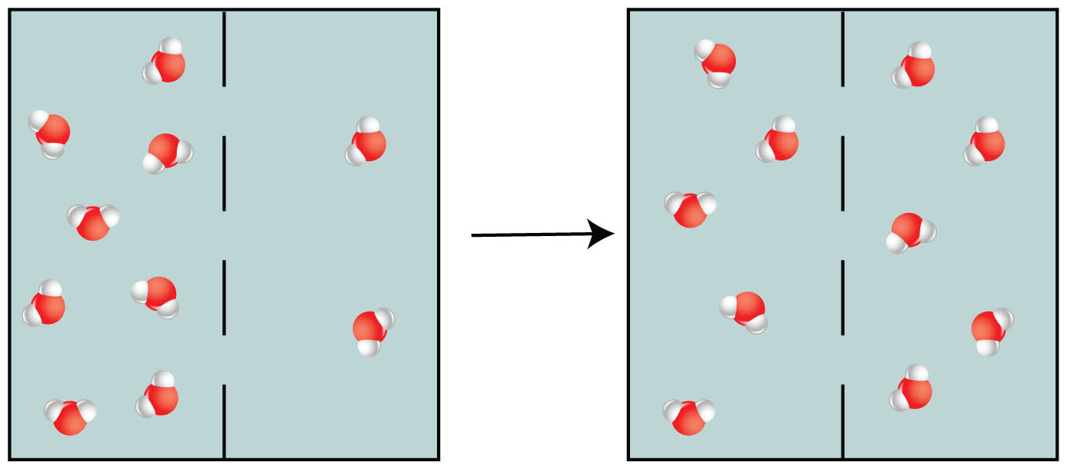
Dynamic Equilibrium
Molecules are always in movement in and out
Point in diffusion when the concentration is equal inside and outside the cell

Slide 5
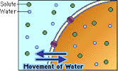
Isotonic
Water moves in and out of cell at the same rate

Slide 6
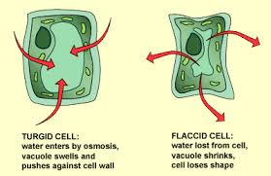
Osmotic/Turgor Pressure
Pressure generated as the water flows into the cell

Slide 7
Osmotic/Turgor Pressure
If the pressure gets too high-
Animal cell – will burst
Plant cell – will not burst because of the cell wall

Slide 8
Homeostasis
Means the cell is in proper balance
The cell has everything it needs

Slide 9
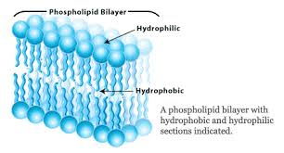
Phospholipid
Hydrophilic – likes water
Hydrophobic-does not like water

Slide 10
Alternative Pathways
CAM –
Cactus
C4 Plants –
Other plants
Keep their stomata closed during the day when its too hot.
Only open it at night

Slide 11
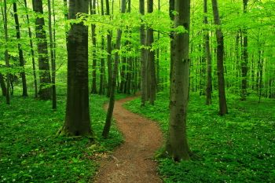
Chlorophyl
Green plants are green because they contain a pigment called chlorophyll.
Green light is not absorbed but reflected, making the plant appear green.

Slide 12
Metabolic Processes
Anabolic
Photosynthesis
Catabolic
Cellular Respiration
(The C at the beginning of each word)

Slide 13
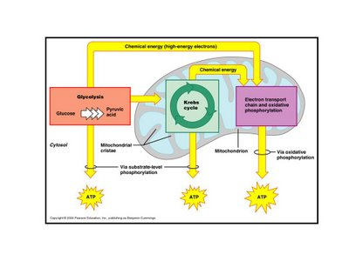
Glycolysis
First step in cell cellular respiration
Anaerobic process – does not need oxygen

Slide 14
Glycolysis
Creates 4 ATP –
2 ATP need to go back in to keep cycle going
NET - 2 ATP
Creates 2 Pyruvate
Pyruvate is where the energy from glucose is stored

Slide 15
Phtosynthesis
Reactants and Products of Photosynthesis
Notes:
reactants

Slide 16
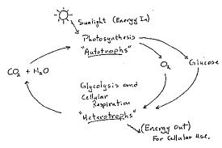
Phtosynthesis
The products of one process are the reactants for the other process

Slide 17
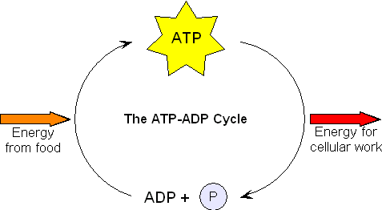
ATP to ADP
When a phosphate is released, energy is also released.

Slide 18
ATP
Cellular Respiration releases the most ATP of any process
Step 4 of cellular respiration, the electron transport system. It releases 32 ATP.

Slide 19
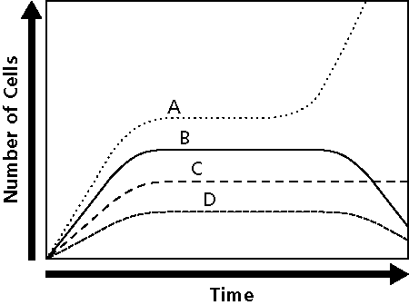
Carcinogens
Are Cancer Causing
Cause failure in the regulation of cell growth, so the cells grow uncontrolled

Slide 20
Goal/Purpose of Mitosis
Asexual Reproduction
Occurs in body cells - example – skin cells
Important because it allows body to grow new cells and replace damaged cells

Slide 21
Mitosis
A newly formed cell in Mitosis has equal number of chromosomes as the parent cell.
Results in 2 identical copies of the parent
Example: Parent has 46 chromosomes – each offspring will also have 46

Slide 22
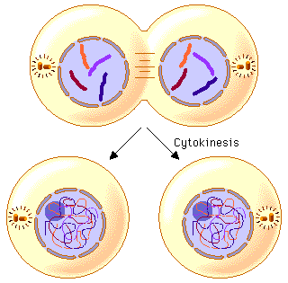
Cytokenesis
Process that occurs right after Telophase
Cytoplasm divides into daughter cells

Slide 23
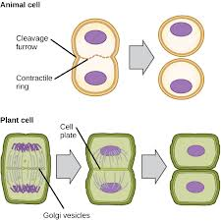
Cytokenesis
PLANT CELL – a new plate forms between the two daughter cells

Slide 24
Healthy Cells
Are SMALLER
Because they do not have to transfer and diffuse materials over a large area.
Communication is also easier
Ratio of surface area to volume DECREASES

Slide 25
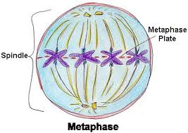
METAPHASE
The Spindle Fibers on the opposite side of the cell pull the chromosomes to the middle
They line up on the equator in the middle of the cell

Slide 26
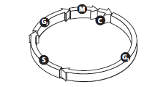
Cell Cycle
G 1 PHASE
The beginning of the cell cycle

Slide 27
Cell Cycle
Metaphase
shortest of the phases in Mitosis.
Metaphase ensures that the new cells have accurate copies of the chromosomes

