Slide 1
Chapter 6
Section 3
Water and Solutions

Slide 2
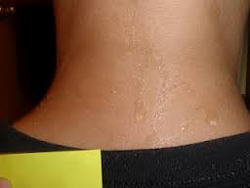
Main Idea
The properties of water make it well suited to help maintain homeostasis in an organism.
Homeostasis is the ability of an organism (even a cell) to maintain a condition of equilibrium or stability within it internal environment when dealing with external changes.

Slide 3
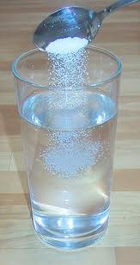
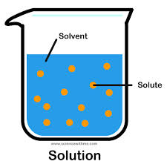
Water and Solutions
Water accounts for approximately 70 % of a cells mass.
Water is called the universal solvent
Because many substances dissolve in it.
Water is
adhesive and cohesive

Slide 4
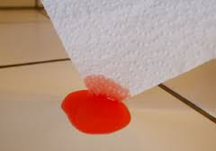
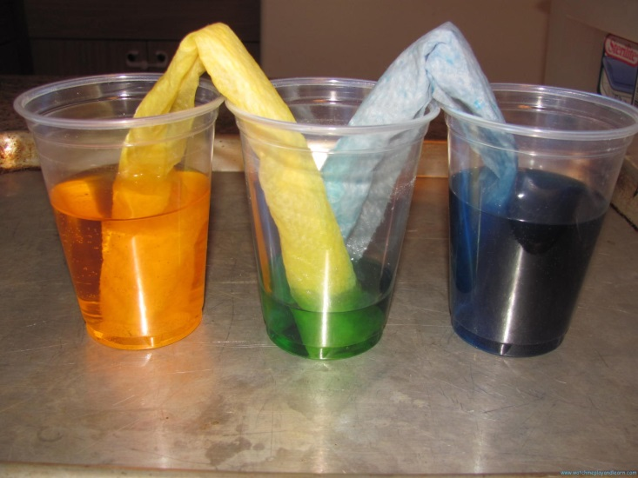
Water and Solutions
Water is –
Adhesive: it bonds to other surfaces
Capillary action is the result of adhesion
Capillary action - is the ability of a liquid to flow in narrow spaces without the assistance of, and in opposition to, external forces like gravity.
The effect can be seen in the drawing up of liquids between the hairs of a paint-brush, in a thin tube, in porous materials such as paper.

Slide 5
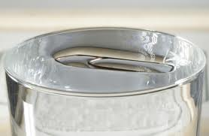
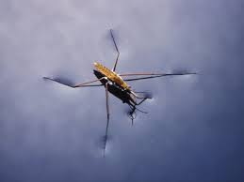
Water and Solutions
Water is –
Cohesive – the molecules are attracted to each other.
Surface tension is the result of cohesion
tendency of the surface of a liquid that allows it to resist an external force.
For example, in the floating of some objects on the surface of water, even though they are denser than water, and in the ability of some insects (e.g. water striders) to run on the water surface.

Slide 6
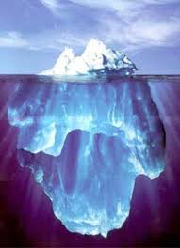
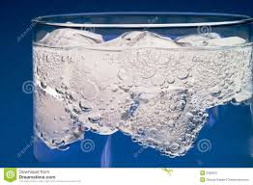
Water and Solution
Water is less dense as a solid than as a liquid.
This is why ice cubes float.
More dense substances sink
Less dense substance float

Slide 7
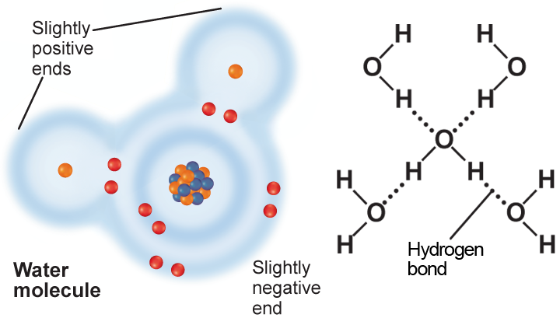
Water’s Polarity
Molecules having pomposity charged regions are called polar molecules.
The oxygen end of a water molecule has a slightly negative charge
The hydrogen end of a water molecule has a slightly positive charge
This is due to the unequal sharing of electrons.

Slide 8
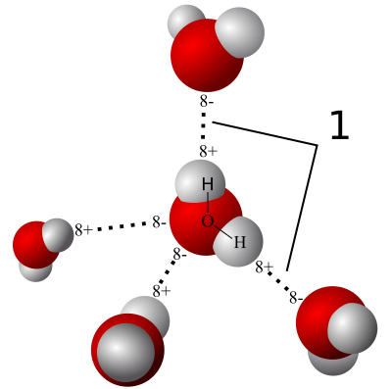
Water’s Polarity
When a charged region of a water molecule comes close to the oppositely charged region of another water molecule, a hydrogen bond forms.
The name hydrogen bond is something of a misnomer, as it is not a true bond but a particularly strong attraction, and should not be confused with a covalent bond.

