Slide 1
Chapter 6
Section 3
Mixtures, Acids & Bases,
pH and Buffers

Slide 2
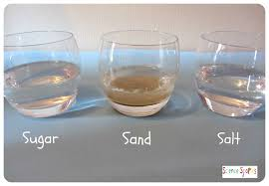
Mixtures
Mixtures are a combination of 2 or more substances that each retains it individual properties.
Homogeneous mixtures
Heterogeneous mixtures

Slide 3
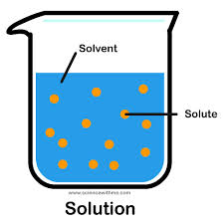
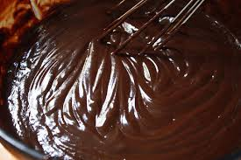
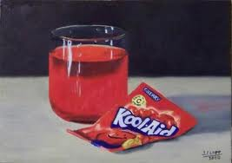
Homogenous Mixtures
Homogeneous mixtures or solutions:
Have a uniform composition throughout
Solutions consist of:
Solvent – a substance in which another substance is dissolved in.
Solute – a substance that is dissolved in the solvent
Examples – Kool-Aid, Sugar Cookie

Slide 4
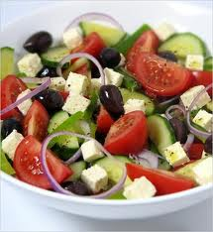
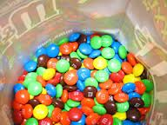
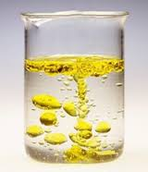
Heterogeneous Mixtures
Heterogeneous mixtures:
Have components that remain distinct
Such as suspensions and colloids
Suspensions – liquids that the particles do not dissolve in
Colloids – look very similar to solution, however chemically the particle do not dissolve in the liquid

Slide 5
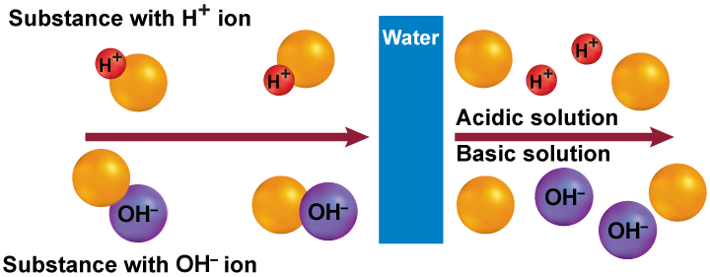
Acids & Bases
Substances that release hydrogen ions (H⁺) when dissolved in water are called acids.
Substances that release hydroxide ions (OH⁻) when dissolved in water are called bases.

Slide 6
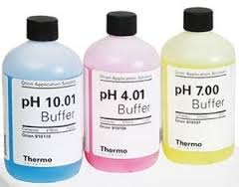
pH and Buffers
The measure of concentration of (H⁺) in a solution is called pH.
pH – really means percent (%) Hydrogen
Buffers are mixtures that can react with acids or bases to keep the pH within a particular range.

Slide 7
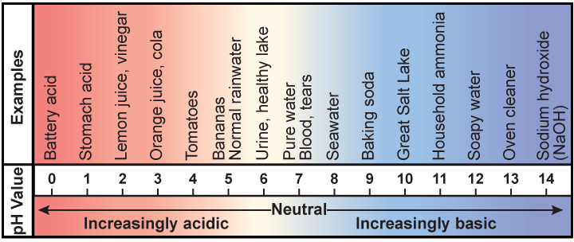
pH and Buffers
Acidic solution have more (H⁺) than (OH⁻) and have pH values lower than 7.
Basic solutions have more (OH⁻) than (H⁺) and have pH values higher than 7.

