Slide 1
Chapter 4
Section 1

Slide 2
Population Growth Rate
Population Growth Rate = PGR
Tells us how fast a population grows
Natality = birthrate in a given time period
Mortality = death rate in a given time period
Emigration = # of individuals moving away from a population
Immigration = # of individuals moving into a population

Slide 3
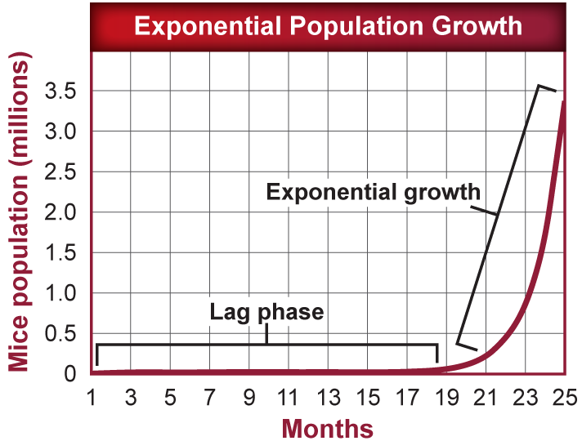
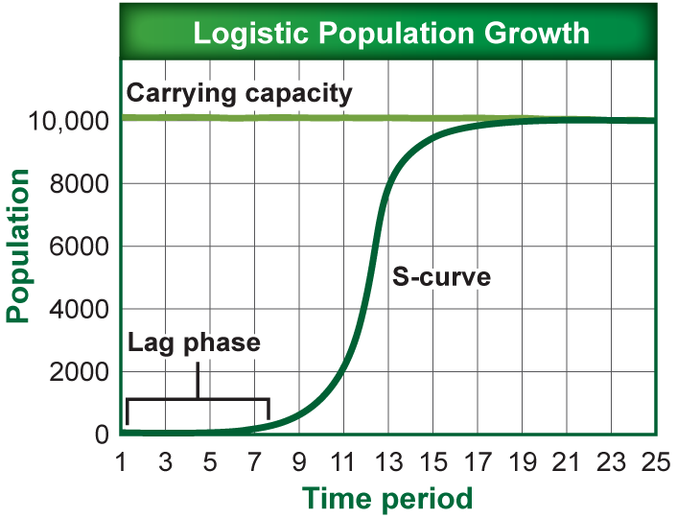
Models of Population Growth
There are 2 models that we used to discuss population growth
Exponential
Logistical

Slide 4
Exponential Growth Model
Exponential growth occurs when the growth rate is proportional to the size of the population.
All populations grow exponentially until some limiting factor slows the populations growth.

Slide 5
Exponential Growth Model
Exponential growth results in a J-shaped curve.
Eventually, the resources become limited and the growth of the populations slows down.

Slide 6
Exponential Growth Model
Reading the Graph:
The lag phase is approx. 17 months
Exponential growth occurs for approx. 4 months
Took 23 months for the population to reach 1 million
Took 1 month for the population to increase from 1 to 2 million
The population grew by approx. 750,000 (0.75 million) between the 21st and 23rd month.

Slide 7
Logistic Growth Model
The populations growth slows or stops following exponential growth once the population reaches its carrying capacity.
Carrying capacity – is the maximum number of individuals that the environment can support.

Slide 8
Logistic Growth Model
Logistical growth results in an S-shaped curve.
A populations stops increasing when the number of births is less than the number of deaths or when emigration exceeds immigration.

Slide 9
Logistic Growth Model
Using the graph:
Exponential growth is occurring between the 9th and 13th time periods.
The Carrying capacity of the population is 10,000
It took a time periods of approx. 19 months for this population to reach its carrying capacity
Exponential growth stopped once the population reached 8,000 individuals

Slide 10
Reproductive Patterns
Species are put into 2 different groups based on their reproductive factors, which are called:
R-strategists
K-strategists
These factors include:
The number of births per reproductive cycle
The age that reproduction begins
The life span of the organism

Slide 11
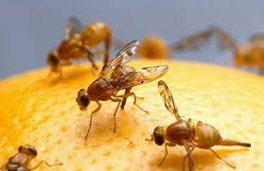
R-strategy
R-strategy = Rate strategy
Is an adaption for living in an environment where fluctuation in biotic or abiotic factors occur
Examples
Availability of food
Changing temperatures
Organism usually has a short life span (fruit fly)
Organisms take advantage of environmental factors

Slide 12
R-strategy
R-strategy = Rate strategy
Is a small organism
Has a short life span
Produces many offspring
Expends little to no energy raising offspring
Is controlled by DIF (density independent factors)
DIF (usually abiotic)
Climate
Temperature
Precipitations

Slide 13
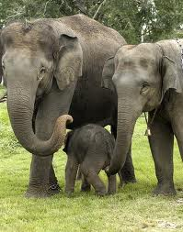
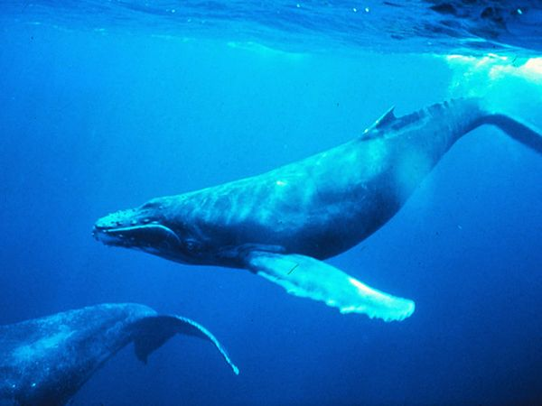
K-strategy
K-strategy = carrying capacity strategy
It is an adaptation for ling in a stable environment
Examples:
Humans
Elephants
Whales

Slide 14
K-strategy
K-strategy = carrying capacity strategy
Is a larger organism
Has a long life span
Produces few offspring
Expends a lot of energy raising offspring
Is controlled by DDF (density dependent factors)
DDF (are usually biotic)
Predation
Competition
Disease/Parasites

