Slide 1
Chapter 9
Section 1
The Cell Cycle

Slide 2
INTRODUCTION
Once a cell reaches its size limit, either it will stop GROWING or it will DIVIDE.
Cellular reproduction allows organisms to GROW and replace damaged cells.
This process is called the Cell Cycle

Slide 3
THE (EUKARYOTIC) CELL CYCLE
Consists of 3 main stages
Interphase (cell grows, carries out cellular functions, and makes copies of its DNA – called replication)
Mitosis (cell’s nucleus and nuclear material divide)
Cytokinesis (cells cytoplasm divides making 2 cells)

Slide 4
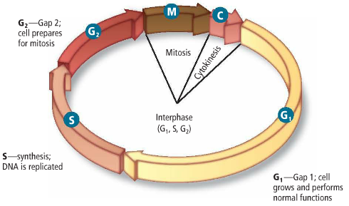
Interphase
Also consists of three stages
a. G₁ stage (Gap 1)
b. S stage (Synthesis)
c. G₂ stage (Gap 2)

Slide 5
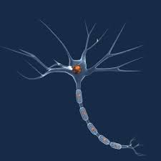
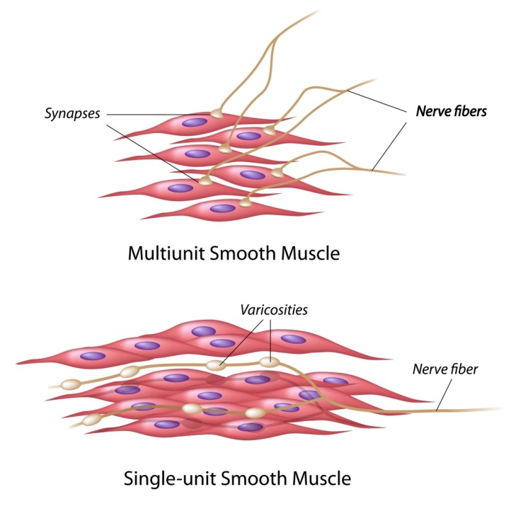
G₁ stage (Gap 1)
The stage that immediately follows cell division
The cell GROWS, carries out normal cell functions, and prepares to replicate its DNA
Some cells exit the cell cycle at this point and do not divide again
(MUSCLE and NERVE cells)

Slide 6
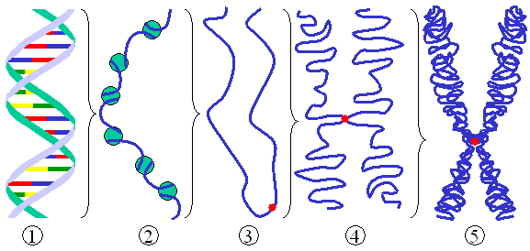
S stage (Synthesis)
The stage that immediately follows G₁
The cell replicates its DNA (which is in the form of CHROMATIN at this point)
Chromatin is the relaxed form of DNA in the cell’s nucleus

Slide 7
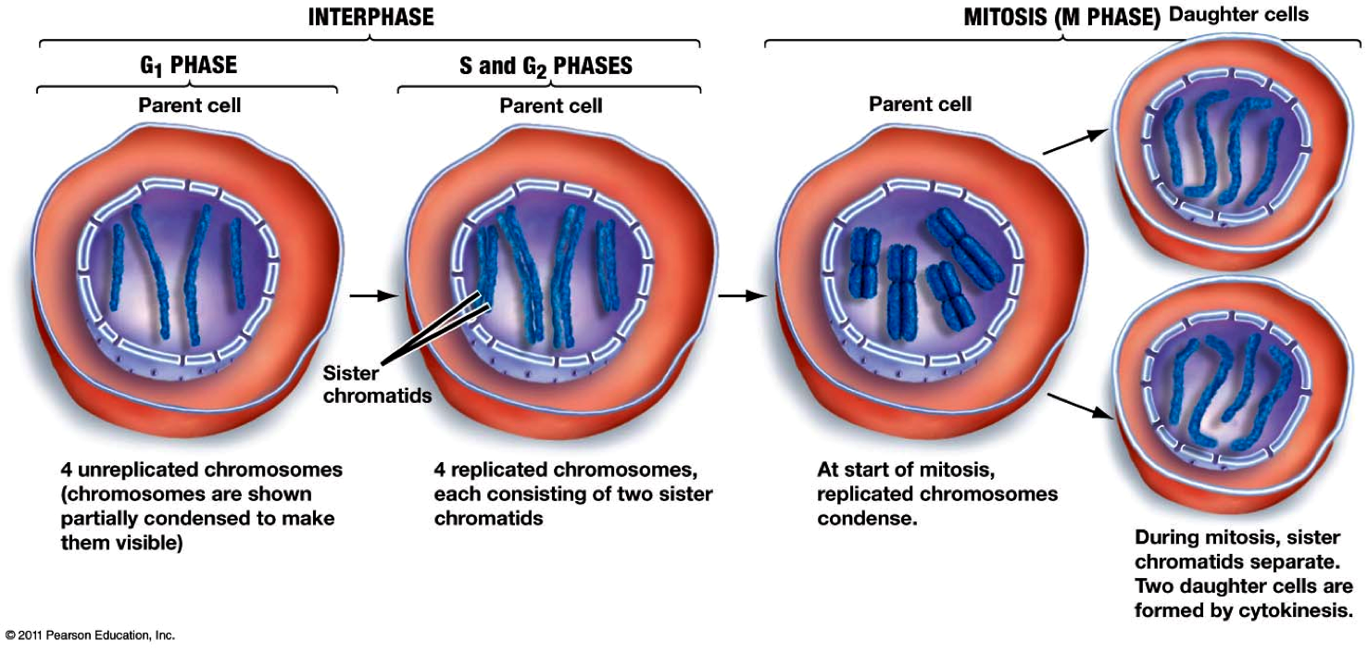
G₂ stage (Gap 2)
The stage that immediately follows S
The cell prepares for MITOSIS (the division of its NUCLEUS & NUCLEAR MATERIAL)

