Slide 1
Chapter 8 Cellular Energy
Section 1
How Organisms Obtain Energy

Slide 2
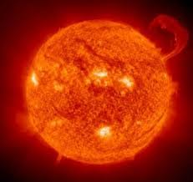
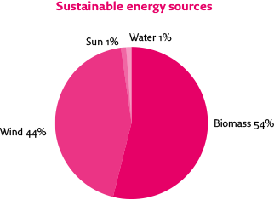
Theme Focus
The Sun is the source of nearly all of the energy on Earth.

Slide 3
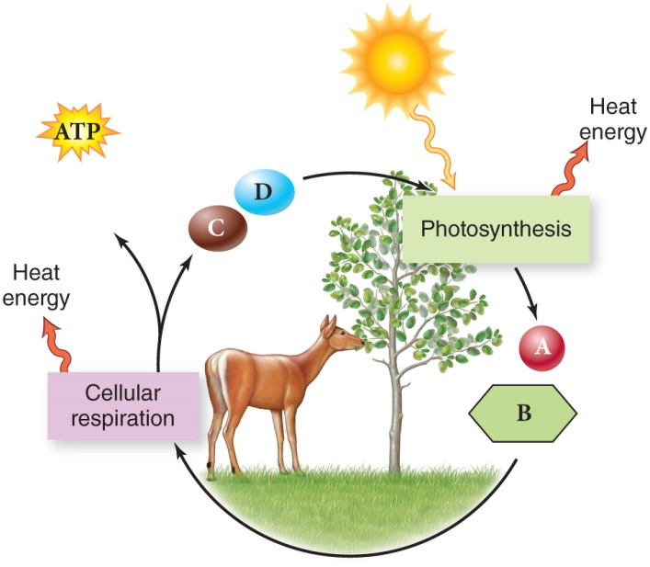
Big Idea
Photosynthesis converts the Sun’s energy into chemical energy, while Cellular Respiration uses chemical energy to carry out life functions.

Slide 4
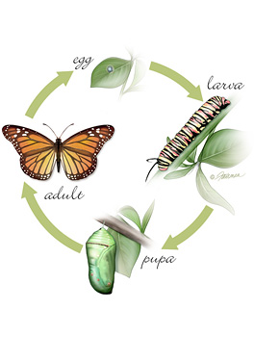
Main Idea
All living organisms use energy to carry out all biological processes.
What are some biological processes?
Reproduction
Cell replication
Digestion
Metamorphosis
Photosynthesis
Transpiration
Many, Many More!

Slide 5
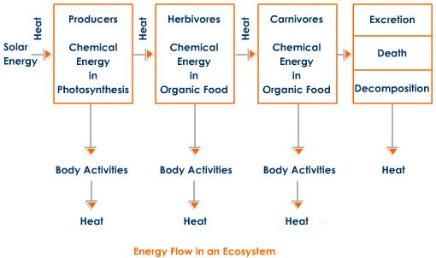
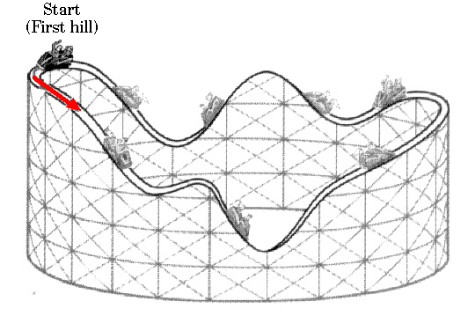
Transformation of Energy
All Cellular activities require energy
Energy is the ability to do work
The study of the flow and transformation of energy is called Thermodynamics

Slide 6
Laws of Thermodynamics
First Law – Law of conservation of energy
Energy can be converted from one form to another
But it cannot be created nor destroyed
Second Law – Entropy Increases
Energy cannot be converted without the loss of usable energy (usually as heat)
Entropy is the measure of disorder or usable energy in a system

Slide 7
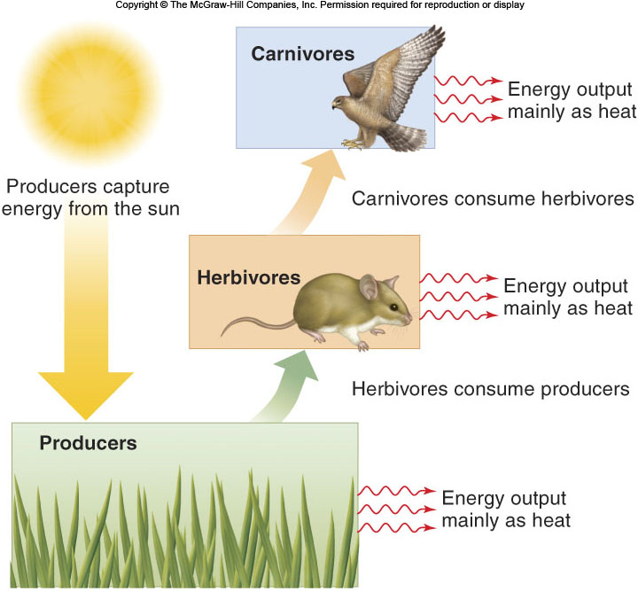
Autotrophs & Heterotrophs
Autotrophs are organisms that make their own food
Heterotrophs are organisms that must obtain food from other organisms.
Energy flows from the sun to Autotrophs to Heterotrophs.

Slide 8
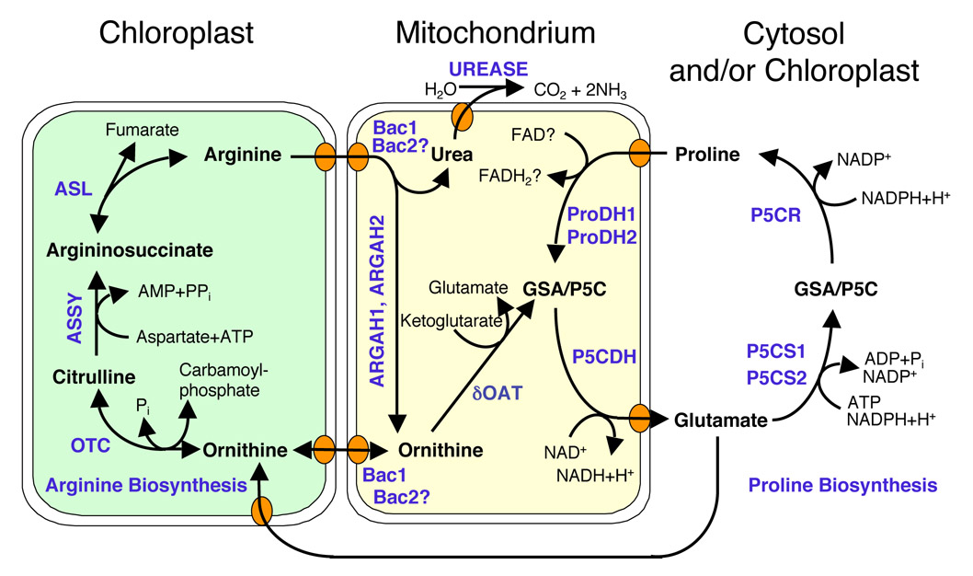
Metabolism
Refers to all of the chemical reactions in a cell.

Slide 9
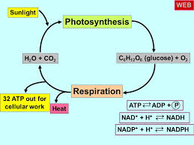
Metabolism
A metabolic pathway is a series of chemical reactions in which the product of one reaction is the substrate (reactant) for the next reaction.

Slide 10
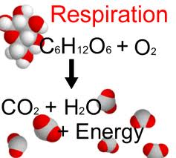
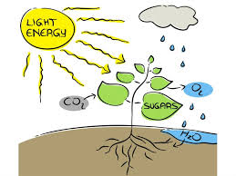
Metabolism
2 Types of Metabolic Pathways
Catabolic pathway – releases energy by breaking down larger molecules into smaller molecules
Cellular respiration
Anabolic pathways use the energy released by catabolic pathways to build larger molecules from smaller molecules
Photosynthesis
Light from the sun is converted to chemical energy for use by the cell

Slide 11
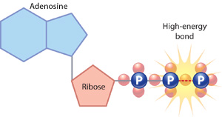
ATP
ATP (Adenosine triphosphate)
Is a molecule that stores chemical energy that can be used by cells in a variety of reactions.
It is a nucleotide (macromolecule) that is made of:
Adenine base
Ribose sugar
3 phosphate groups

Slide 12
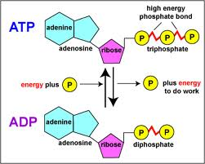
ATP
ATP releases energy when the bond between the second and the third phosphate group is broken
This forms a molecule called ADP and a free phosphate group
ATP is reformed when ADP receives a phosphate group and energy
This is stored in the bond between the second and third phosphate group

